Slide 1

Book Recommendation Project
Bookworms
Gamze Baysallar
Fatma Özcivan
Elçin Dindar
Nisa Kapukaya

Slide 2

Business Objective:
Providing recommendations to the users based on hybrid filters.
Determining key results such as “top rated books”, “most rated authors” etc.
Finding key insights in terms of age groups & locations of the users
Data Understanding/Summary:
Dataset consists of 3 CSV files: “Book Ratings”, “Books”, “Users”
User ID, Location, Age data are provided in “Users” file
Book title, Author, Publisher, ISBN data are provided in “Books” file
User ID, ISBN and Book Ratings data are provided in “Book Ratings” file
Target Analytical Solutions:
Default : Data Preparation Process, Summary Tables and Graphs, Statistical Tests
Data will be analysed by the help of Excel, Python and the key findings will be illustrated with PowerBI.
Notes:
CSV okutmakta zorlandık,latin harf olmayan karakterler vardı bundan dolayı hata veriyordu, bunu encoding-latin ve error badlines ile sildik.
Datamız ham halindeydi bu nedenle yazılan şehir ve ülkelerde hata çok fazlaydı.

Slide 3
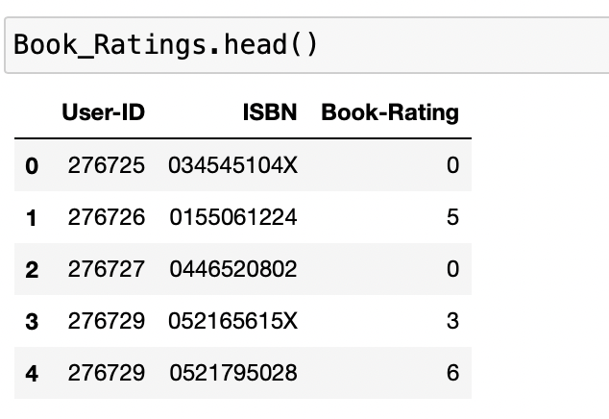
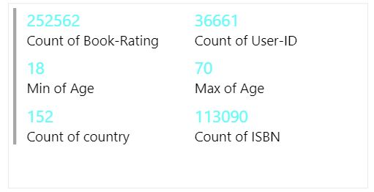
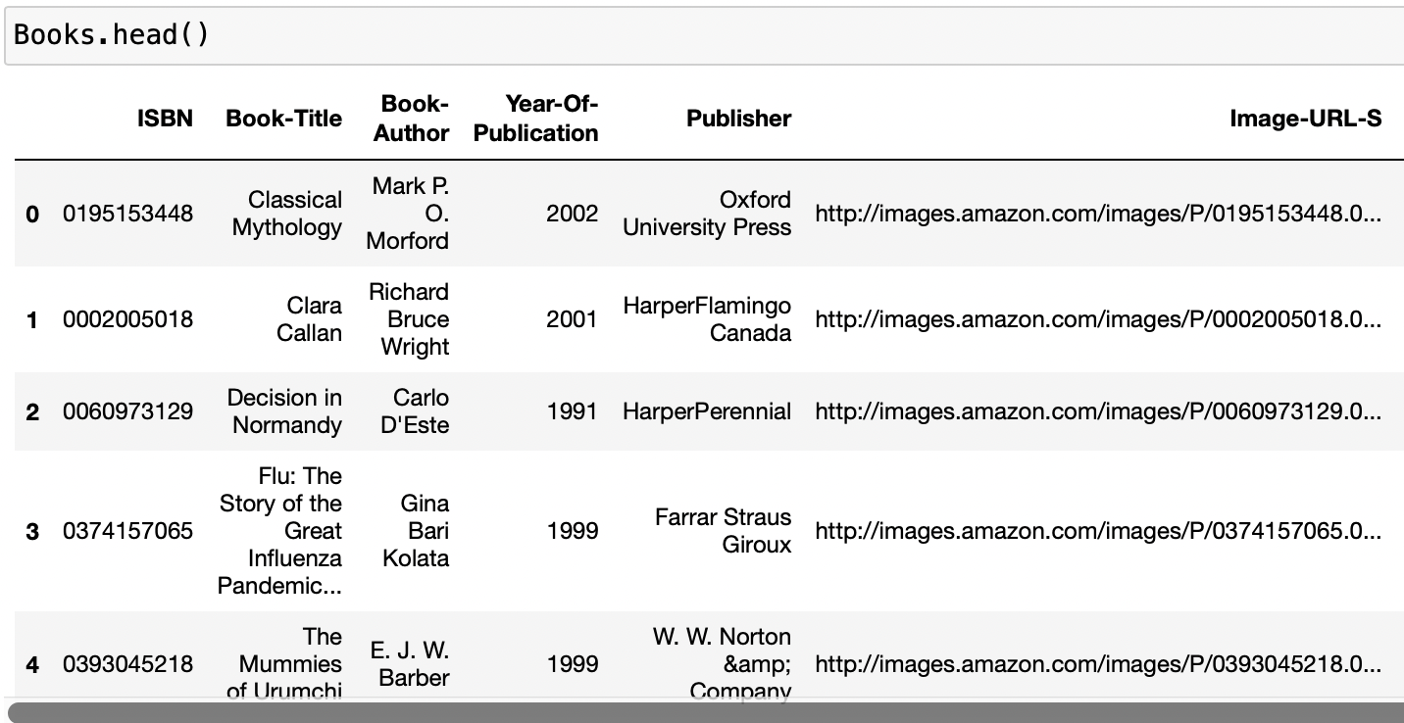
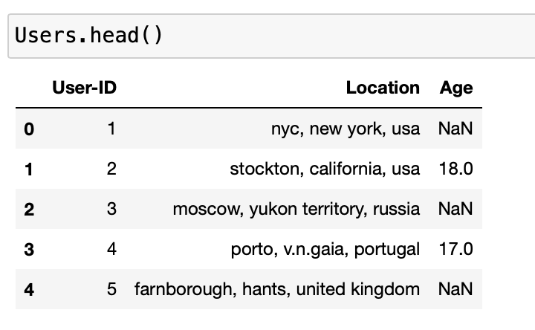
ANALYSIS OF THE TABLES

Slide 4

EDA
What questions are we looking for answers to?
The unique number of people (userıd).
How many books are rated?
Who is the user with the highest rating and how many ratings did he give?
What is the average rating of the author with more than 50 ratings?
Is it possible to comment on the average rating according to the book’s author?
Shall we search and fill in the illogical years one by one on the internet?
After the merge process, there are null values on the same line for a book title, book author, year, and publisher.
Should we delete these values completely or fill these values with appropriate data?

Slide 5
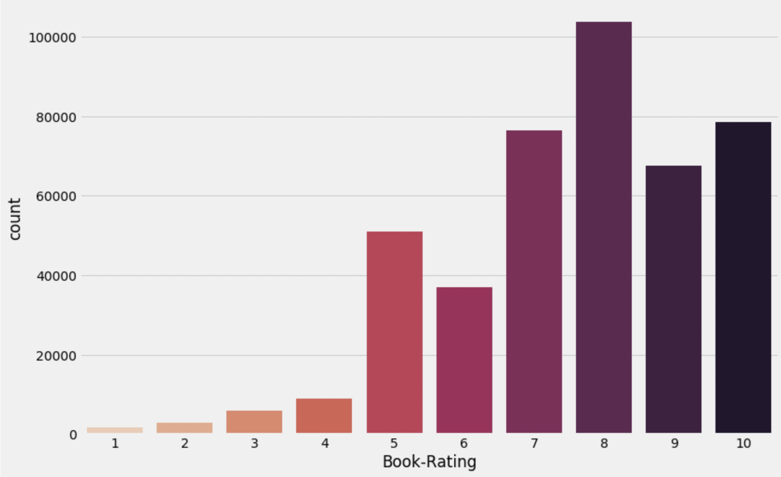
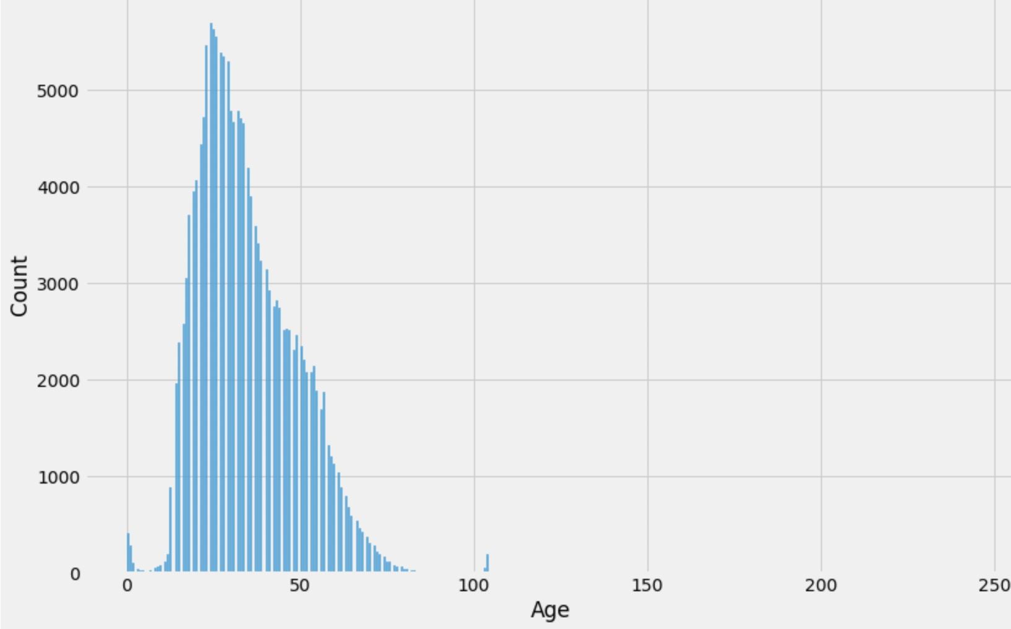
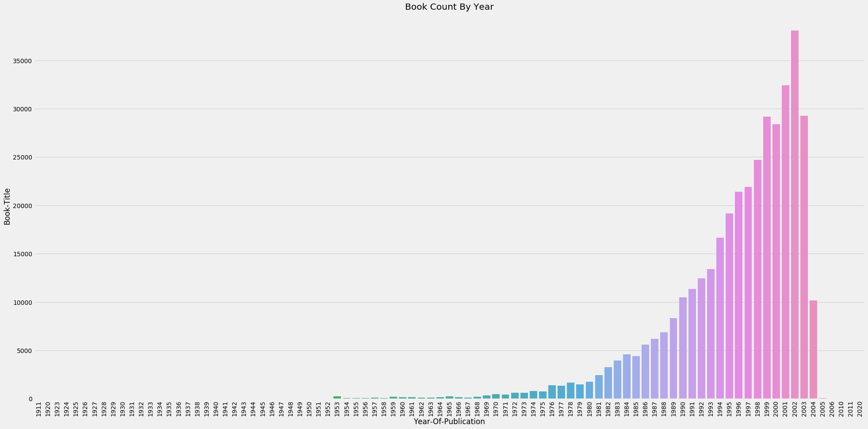
Age Count
Book Rating
Book Count by year
Notes:
Age verisinde çok fazla eksik değer ve outlier değer vardı. Eksik değerleri sildik ve outlierları baskılayarak 18-70 arası yaş aralığını aldık.

Slide 6
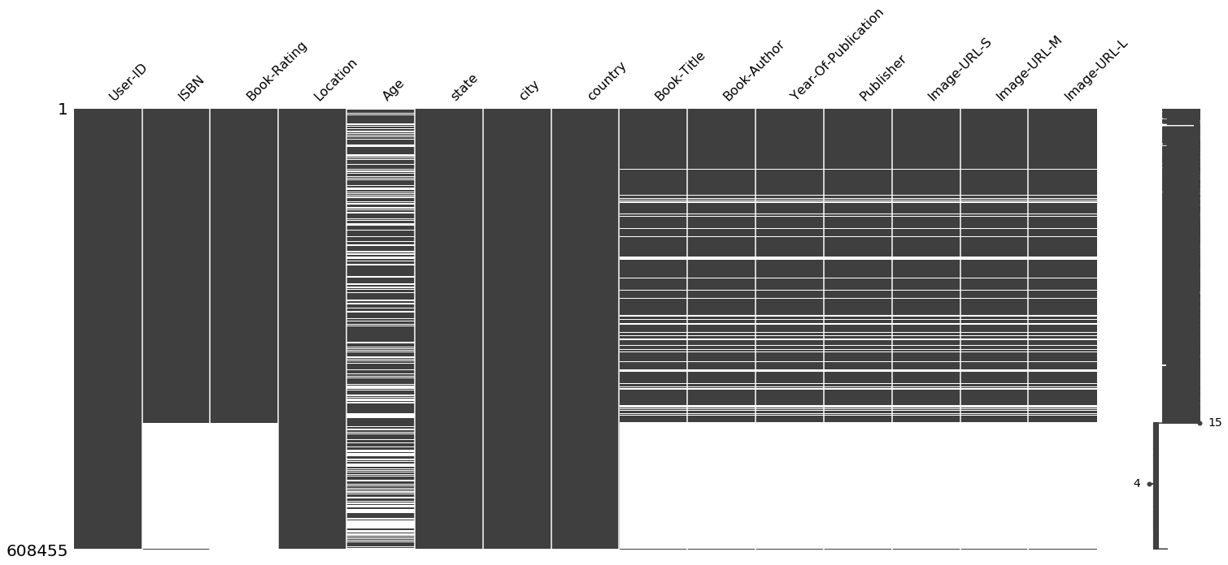
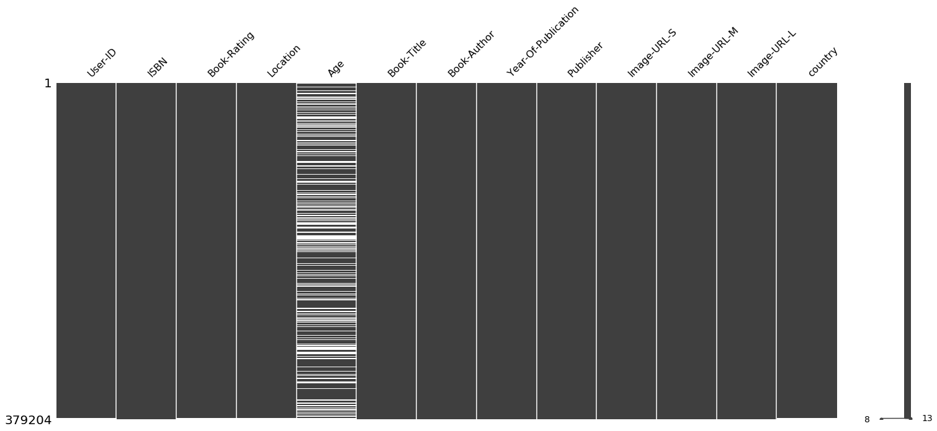
MISSING VALUE ANALYSIS

Slide 7
DATA MANIPULATION
Applied processes:
Deleting unnecessary columns
Deleting rows with 0 book rating values (716109 row)
Separating the values specified in a single column as 'location' into 'state', 'city and 'country’.
Converting the year values written in quotation marks as "1988" or in parentheses as (1988) into a common form as 1988.
Cleaning the values written in various forms in the country column and making them a single form.

Slide 8
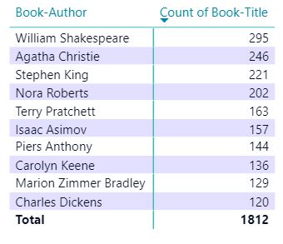
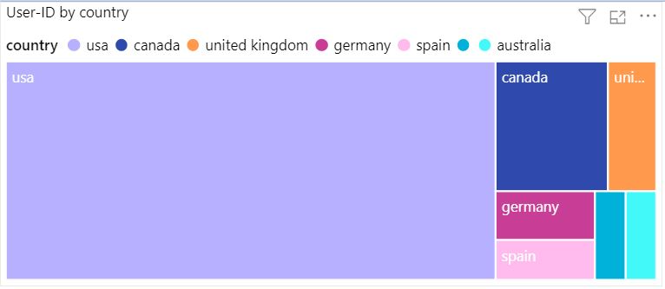
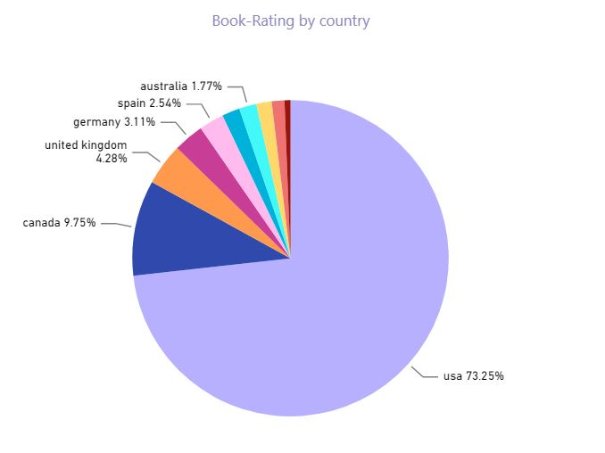

Slide 9
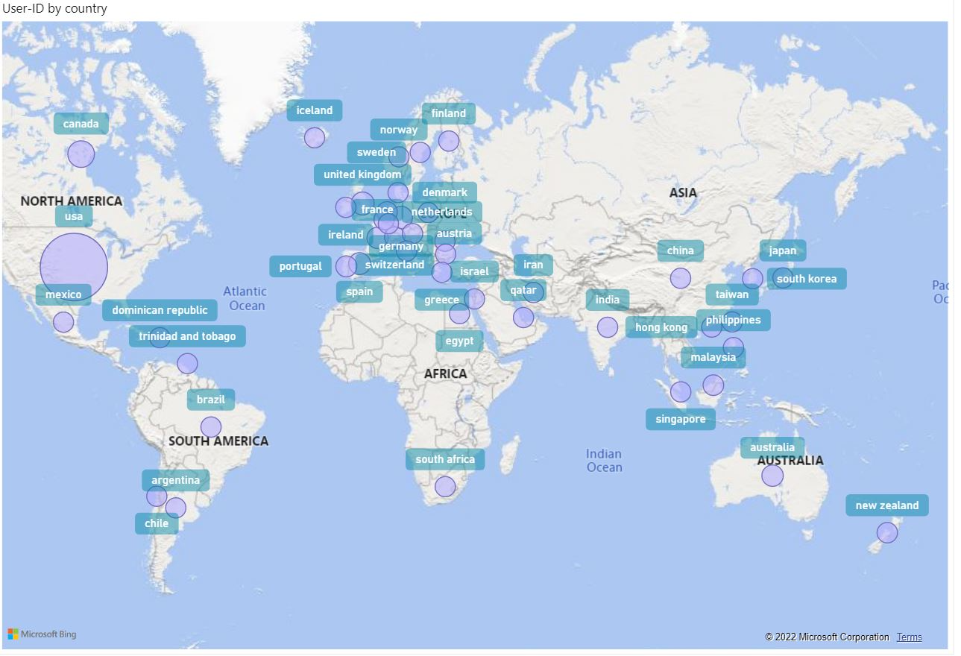

Slide 10
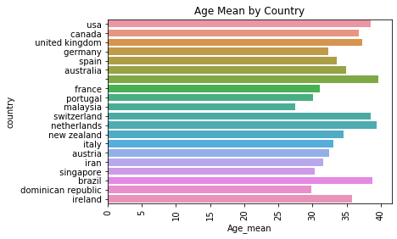
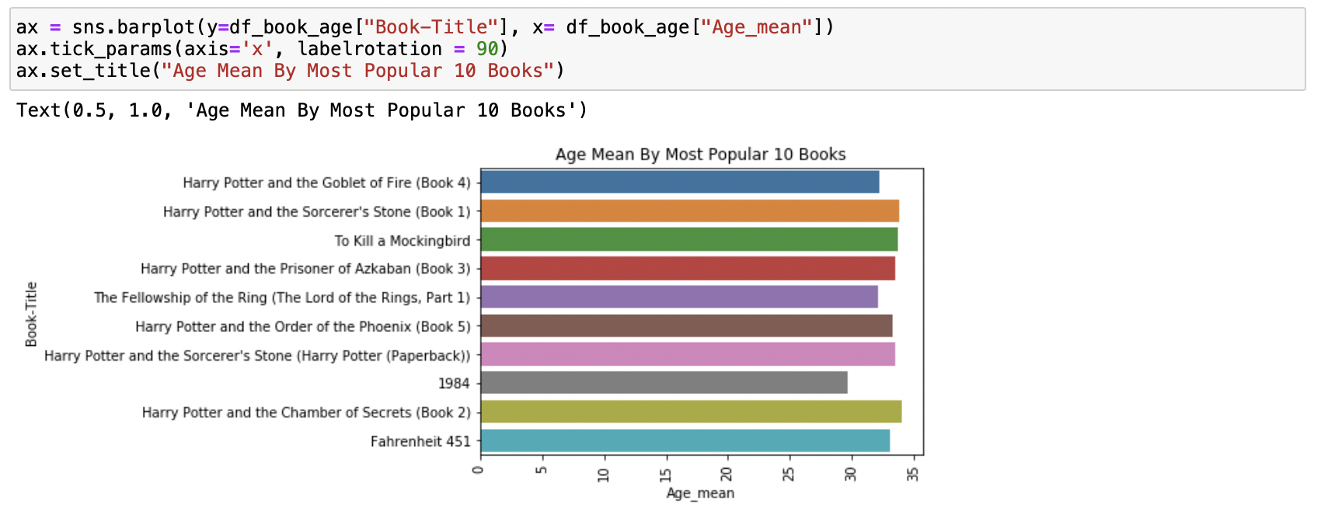
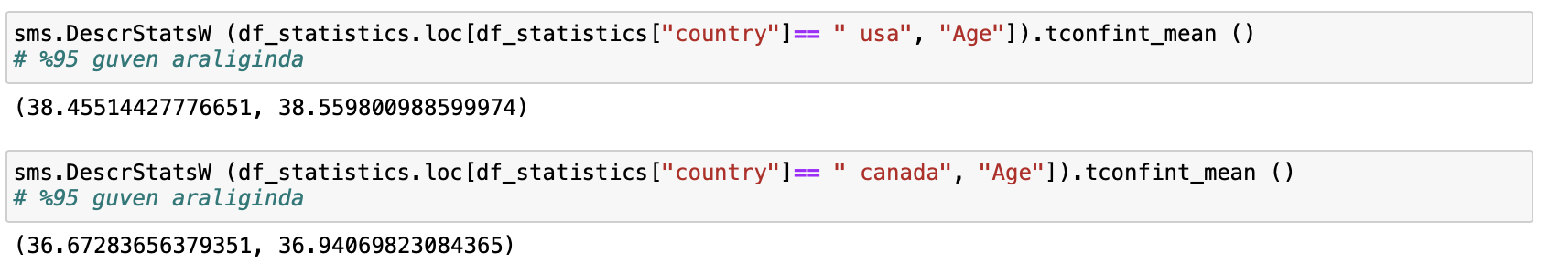
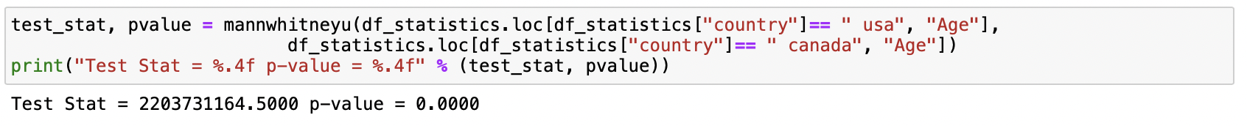
STATISTICAL INFORMATION
Age Analysis

Slide 11
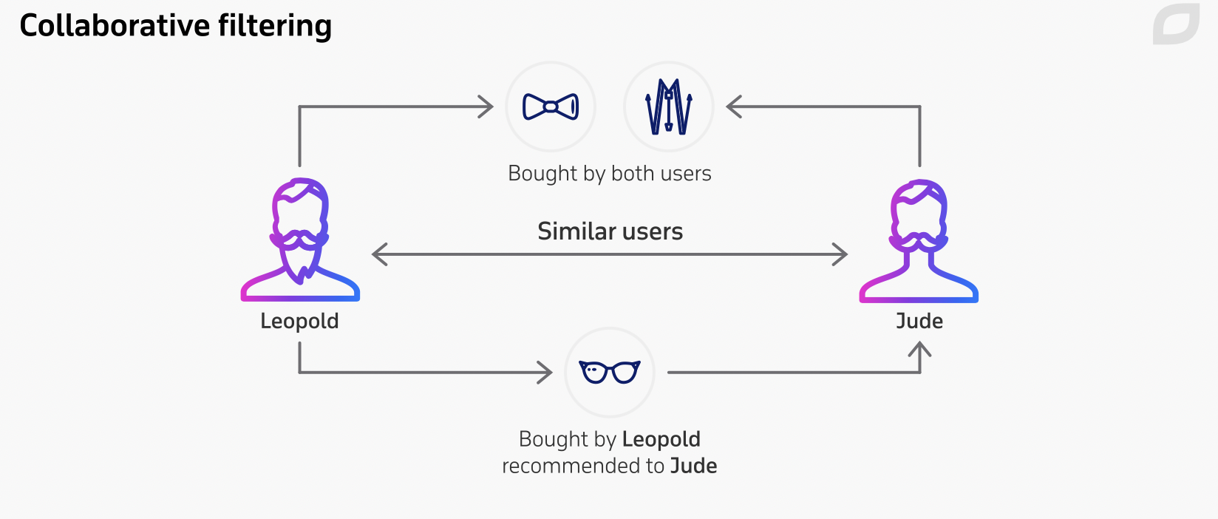
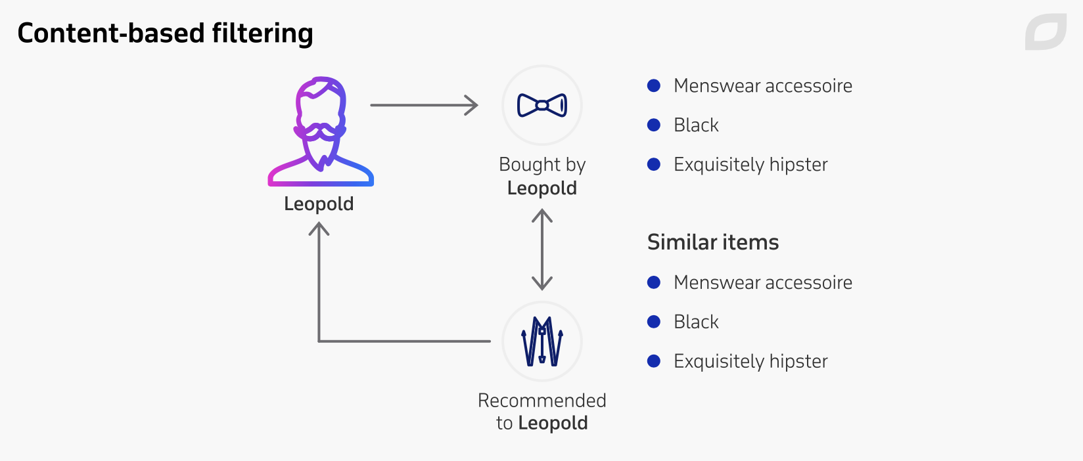
RECOMMENDATION SYSTEMS
Aim to predict users' interests and recommend product items that quite likely are interesting for them.
They are among the most powerful machine learning systems that online retailers implement in order to drive sales.
Recommender systems function with two kinds of information:
Characteristic information. This is information about items (keywords, categories, etc.) and users (preferences, profiles, etc.).
User-item interactions. This is information such as ratings, number of purchases, likes, etc.
Three algorithms used in recommender systems:
Content-based systems, which use characteristic information.
Collaborative filtering systems, which are based on user-item interactions.
Hybrid systems, which combine both types of information with the aim of avoiding problems that are generated when working with just one kind.

Slide 12
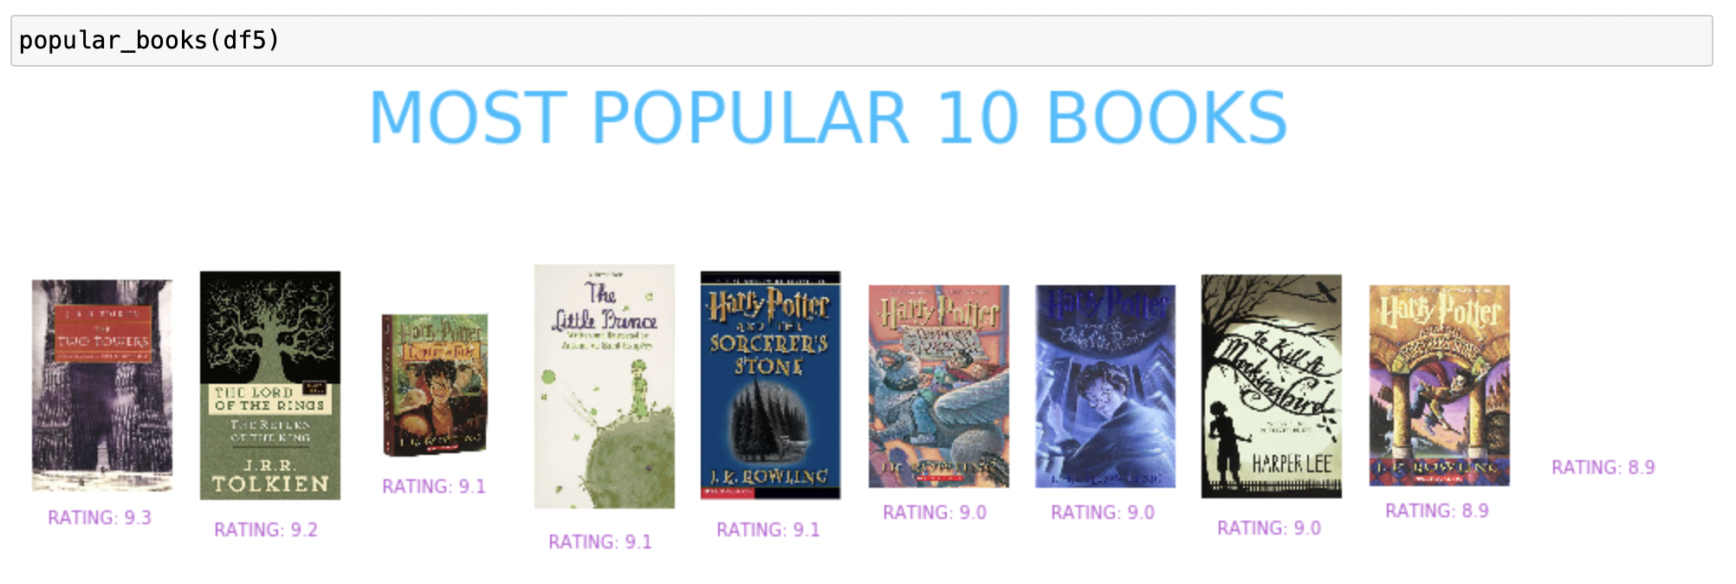
Works on the principle of popularity and or anything which is in trend
check about the product or movie which are in trend or are most popular among the users and directly recommend those.
Google News: News filtered by trending and most popular news.YouTube: Trending videos.
POPULARITY BASED RECOMMENDATION

Slide 13
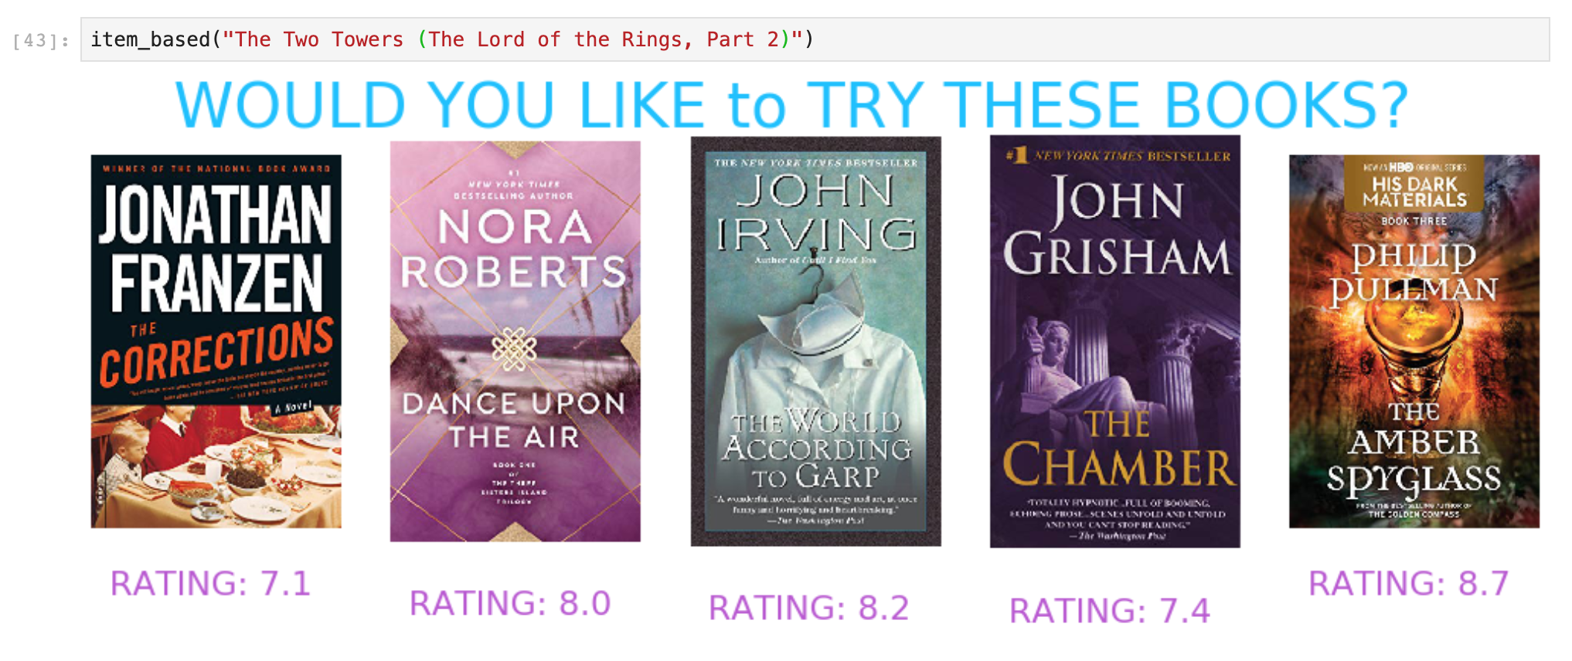
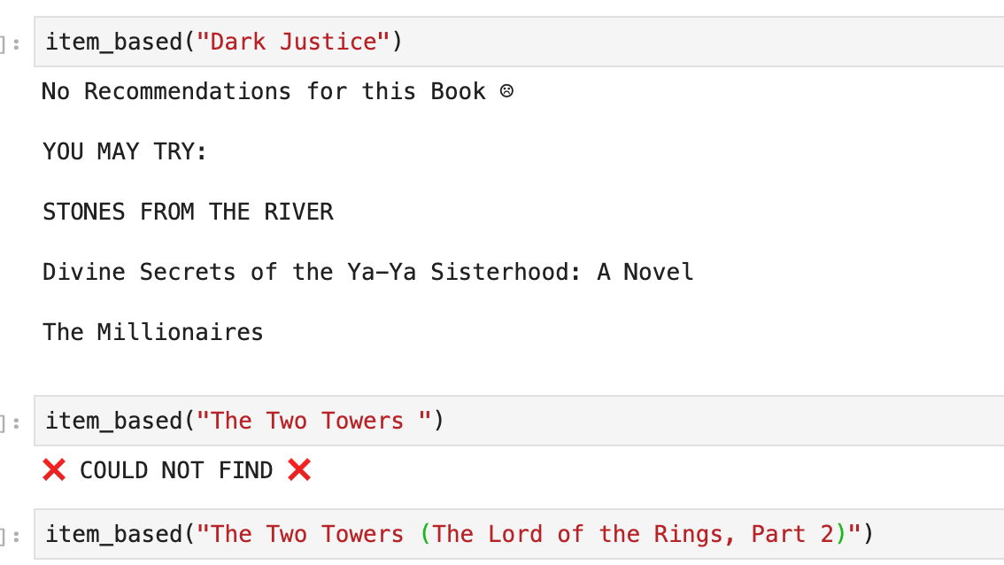
ITEM BASED RECOMMENDATION
Works on the principle of similar content
There are various fundamentals attributes that are used to compute the similarity while checking about similar content.: Euclidean Distance, Cosine Similarity, Jaccard Similarity:

Slide 14
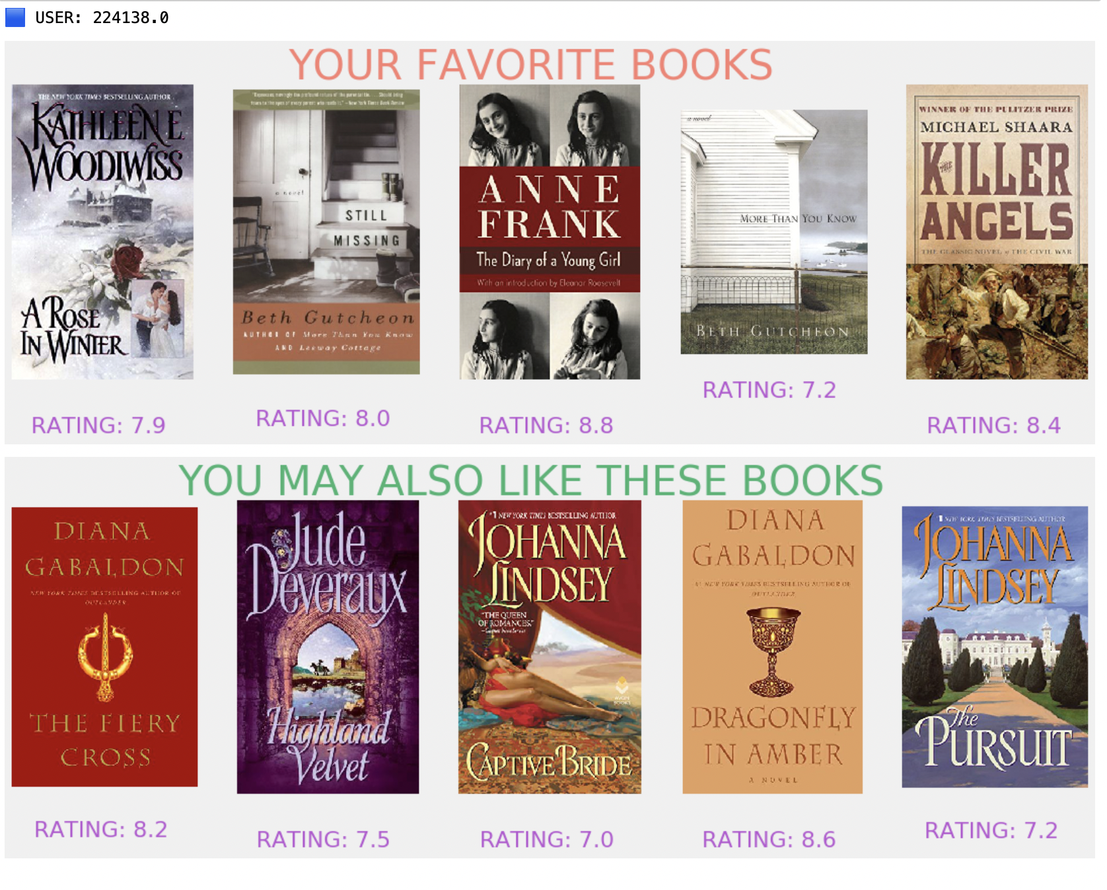
USER-BASED
RECOMMENDATION
Best suited to problem with known data on users (age, gender, occupation, etc)
Aims at finding similar users and recommendations are made to a user based on what a similar user has liked.
The similarity between users is calculated using either Cosine Similarity or Pearson Correlation.

Slide 15
FUTURE WORKS
Hybrid models can be used for accurate recommendation
More features can be considered in similarity algorithms
Streamlit can be used for interactive recommendations

Slide 16

Thank you !

